Slide 2


Today you will need 2 sheets of paper, a pencil, and an R&J book.

Slide 3
Free Writing
This is a brainstorming exercise to help you plan out your argumentative essay.
You will have 10 minutes to write out your thoughts and reasons as to why 1 character is responsible for the deaths of Romeo and Juliet (the character can be Romeo or Juliet themselves).
Do not focus on grammar or spelling when writing this. The point is just to get your thoughts flowing. Don’t look for any text evidence at this point.

Slide 4
Freewrite Cont’d Counterclaim
Now think of the reason why someone would say that your character is not at fault and write it down. (5 minutes)
Now argue against that reason. Why are they wrong? (5 minutes)

Slide 5
Introduction Paragraph
There are 3 parts to an introduction paragraph: The hook, the background information of the issue, and the thesis.
The hook is the attention getter that hooks your reader in. There are many ways to do this, however, for this essay we are going to do a “strong statement”.
Example: Teens spend a majority of their time playing video games when they should be spending their time reading and writing.
Why is this considered a strong statement?

Slide 6
Possible strong statements to use…
Teenage romance can often _________.
Adults often _________ when trying to __________.
Violence always leads to ______________.
Involving others in a romantic relationship can ________________.
Relying on others to solve problems can often _____________.
Parents should never ____________ when it comes to their children.

Slide 7
Introduction – Step 2: Background information
Briefly explain the issue, but DO NOT state your position yet.
What information about the play does the reader need to know before reading your argument? Include the title of the play and author: “Romeo and Juliet” by William Shakespeare
On your free writing paper, write down your strong statement and some basic information that your reader needs to know about the play. Remember – what was the reason why Romeo and Juliet couldn’t be together? What is a brief reason that led to their deaths?

Slide 8
Thesis statement
The last part of your introduction paragraph is the thesis statement. This is usually 1-2 sentences. Your thesis statement states your claim. A claim is your position on the topic. (Remember to avoid using personal pronouns – I, me, my, etc.)
Example: Video games encourage teens to become violent when faced with real world scenarios.
Remember, your thesis statement DOES NOT contain any evidence. Evidence is only placed into body paragraphs.
On your free write paper, write your thesis statement. You need 3 reasons why this character is at fault.

Slide 9
Introduction Example
(Steps 1, 2, and 3)
Parents should never _____________ when it comes to their children. This fact is evident in William Shakespeare’s play “Romeo and Juliet”. In the play, the characters Romeo and Juliet ____________________. This is due to _______________. The character most responsible is __________ because __________, _________, and __________.

Slide 10
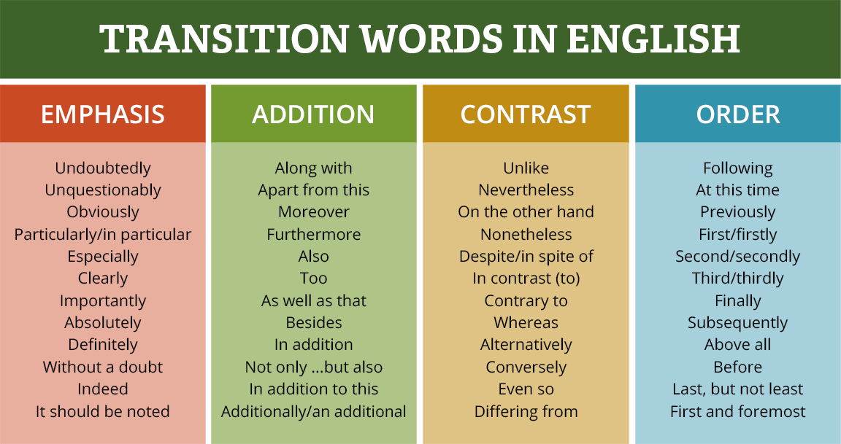
Body Paragraphs
To begin the topic sentence of each body paragraph, you must use a transitional word or phrase. Here are some examples:

Slide 11


Slide 12
Body Paragraph
To begin, ________ is the most at fault for the deaths of Romeo and Juliet because ________ (claim #1). This is because _______________________. For example, the text states, “_________________________” (Act ____ scene _____). In this scene, (explain what happens)_______________________. This choice could have been avoided if he/she _____________. This is the (first, second, or third) reason why ________ is the most at fault.

Slide 13


Slide 14
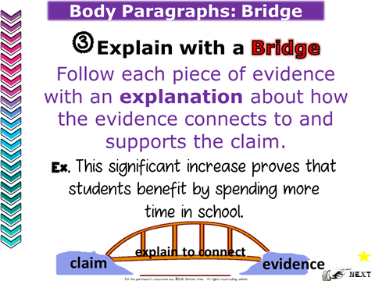

Slide 15


Slide 16
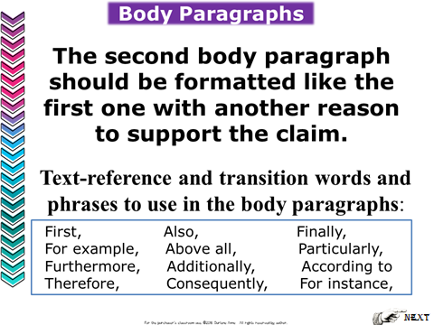

Slide 17
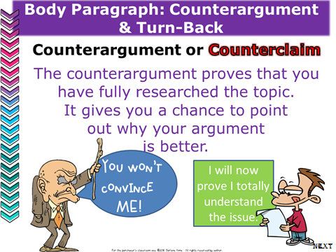

Slide 18
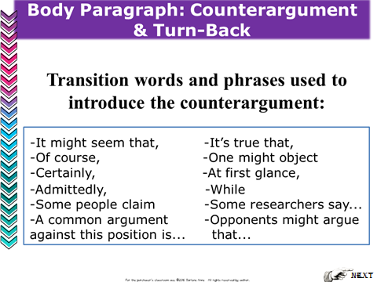

Slide 19
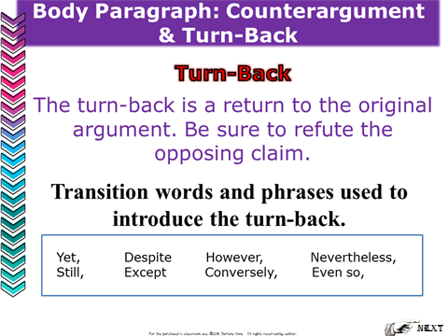

Slide 20
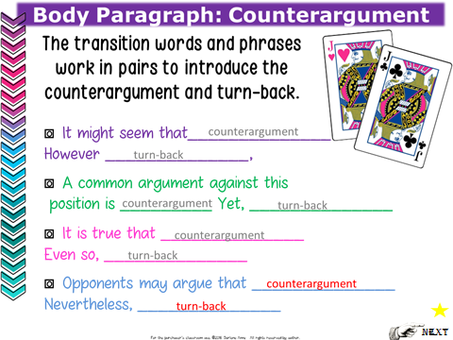

Slide 21


Slide 22
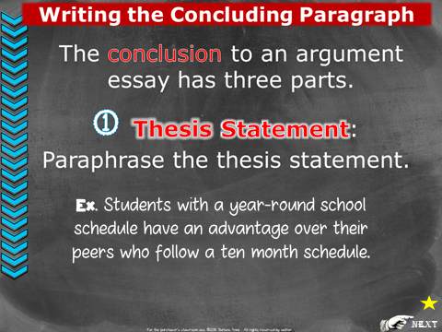

Slide 23


Slide 24
#3 Final Sentence of Conclusion
Thus, due to these factors _____________ is the most at fault for __________________.

